Slide 1
TSN Project

Slide 2
IEEE 802.1Qbv
Focuses on Scheduled Traffic via the Time Aware Shaper
TAS is designed to send traffic in fixed time cycles of equal size
We use guard bands to stop frames from being transmitted too late in the cycle to stop them overflowing into the next cycle and interfering with critical traffic
Guard bands are the size of the maximum frame size
Conversely, we do we do not guard against critical traffic overflowing as it is critical
Traffic flow during each cycle is determined by queues connected to gates with different classes of traffic
Each queue could have a different selection algorithm on which frame is next to go through the gate. Currently this is a FIFO queue (I believe this is where research is being done)
The are 8 gates that can be open or closed encoded by a pre-determined Gate Control list (GCL)
The goal is to reduce latency variation for frames with known timing
Helps TSN to be more deterministic

Slide 3
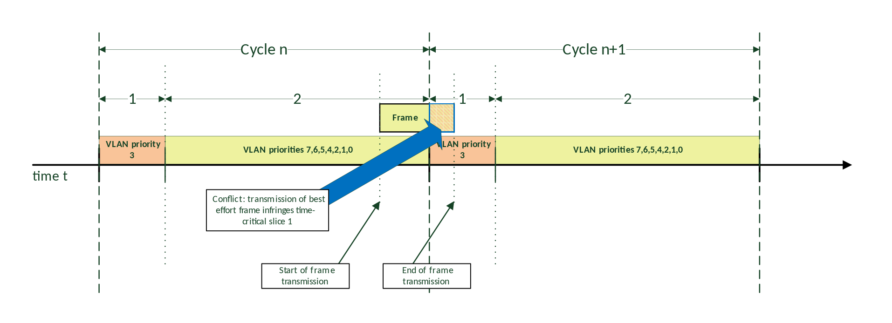
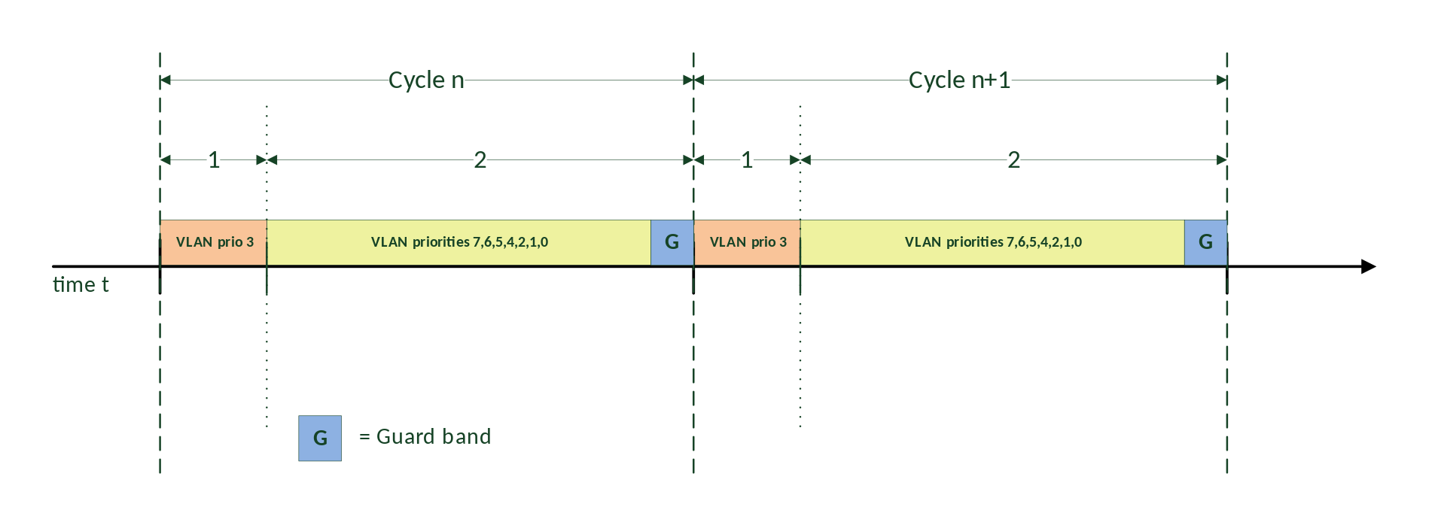
Guard Bands Example
From Wikipedia
Notes:
The top picture shows a frame overflowing into a critical section
The bottom picture shows how we can use a guard band before a critical section to say no more frames can be sent from this point so it doesn’t interfere with critical section
https://en.wikipedia.org/wiki/Time-Sensitive_Networking#TSN_scheduling_and_traffic_shaping

Slide 4
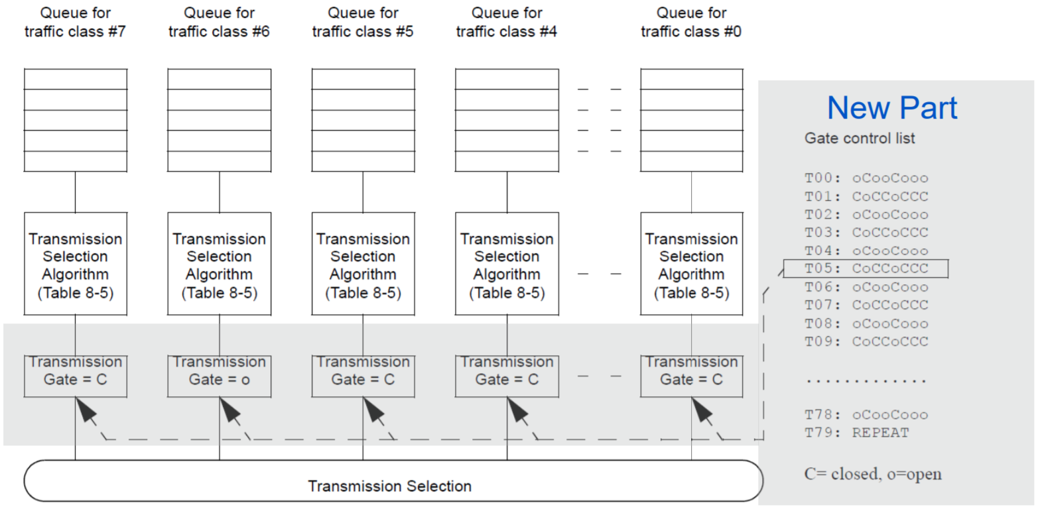
GCL and Scheduling Example
From ieee.org
Notes:
https://www.ieee802.org/1/files/public/docs2017/tsn-farkas-intro-0517-v01.pdf#page=27

Slide 5
IEEE 802.1Qbu
Focuses on Frame Pre-emption
Each traffic class (queue) seen in the slide above is assigned a frame pre-emption value
This can either be express or preemptable (eMAC, pMAC)
Being able to pre-empt non-critical frames allows us to make the guard band seen earlier much smaller
It can be the same size as the largest possible interfering fragment rather than largest possible interfering frame
The pre-empted packed is then resumed in the next cycle after the critical section
This is because there is a layer that stores the remaining frame and then sends it when out of the critical section
This pre-emption is only on a switch -> switch basis and not over longer distances
Each frame is stored with a CRC32 check which is inverted so the switch knows that it is only a part of the frame
The goal of this is to keep the guard bands so to not interfere with time critical traffic, but to also maximise efficiency in having as small a guard band as possible so the network is not idle

Slide 6
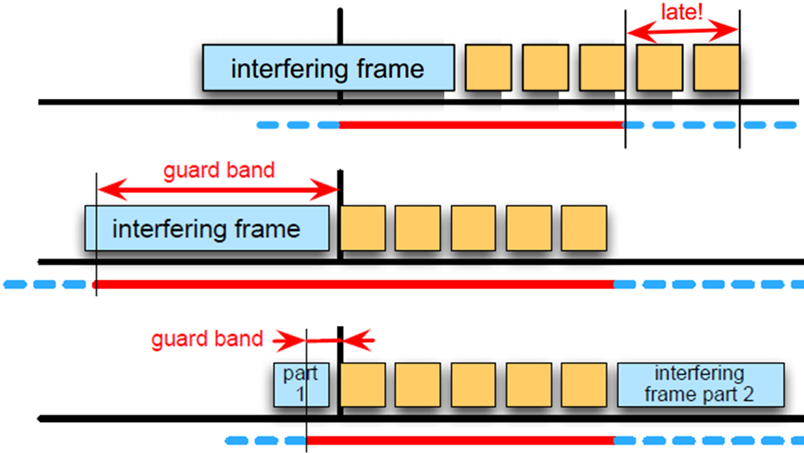
Smaller Guard Band Size Example
Notes:
Shows the comparison between the size of the guard band with and without pre-emption, as well as the effect of no guard band
https://drive.google.com/file/d/0B6Xurc4m_PVsZ1lzWWoxS0pTNVE/view

Slide 7
Current Simulation Methods
OMNeT++ / NeSTiNg
Most widespread simulator, does not allow for flexibility or dynamic changes
It is not abstract enough for what we want to accomplish, lots of fiddly bits
Would be better to go up a layer of abstraction so we can get the data we want

Slide 8
New Simulation Proposal
Functionality Required:
Ability to change policies for queueing each gate traffic (or implement your own)
Needs to be levels of abstraction above OMNeT++ simulators to make it easier to use (only need to define network topology?)
Also needs to be configurable enough in the parts that are relevant to our research
Ideas
Simple interface
Simple config xmls that can be re-used across simulations

Slide 9
Implementation
XML config must include
GCL
Frame & fragment sizes
Link speed
Network topology (list of nodes, switches)
May limit to 2 switches initially for simplicity
Language
Python for simplicity
C++ for functionality, OMNeT++ is also written in C++ if we need to use frameworks/functionality OMNeT has
Output
csv files could be useful initially, to then make graphs out of. Possibly automatic, time permitting (using matlab?)

Slide 10
I believe I would have to do a questionnaire of what we need out of this as there are few examples online of this as it is such a new research topic
I struggled to find demonstrations of OMNET++ in use in the context of TSNs. I think this would be beneficial to see for me to determine what my new simulator needs
Overall:
Need to determine inputs (configuration, topology, speeds, bounds)
Need to determine outputs (jitter, latency, deadlines)

